Slide 1
Sampling Distributions

Slide 2
Sampling Distribution of X̅
The sample mean, X̅, is a random variable.
There are a lot of different values of X̅
Every sample we collect has a different X̅
There is only one population mean, µ.

Slide 3
Sampling Distribution of X̅
If each of you in the class collected your own data you would each get a different X̅
Approx 95% of your X̅’s would be close to µ, within ±2 s.d.
This is because X̅ is a normally distributed random variable – for large samples
X̅ follows a normal distribution centered about µ
This is known as the Central Limit Theorem

Slide 4
Central Limit Theorem
Even if a population distribution is nonnormal, the sampling distribution of X̅ may be considered to be approximately normal for large samples.
What’s large? At least 30; some say 50.

Slide 5

Central Limit Theorem (cont’d)
This “hypothetical” sampling distribution of the mean, as n gets large, has the following properties:
E(X̅) = μ. It has a mean equal to the population mean.
It has a standard deviation (called the standard error of the mean, ) equal to the population standard deviation divided by √n.
It is normally distributed.

Slide 6
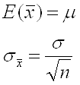
Central Limit Theorem (cont’d)
This means that, for large samples, the sampling distribution of the mean (X̅) can be approximated by a normal distribution with

Slide 7
A Very, Very Small Example
Suppose that in a population consisting of 5 elements and one wishes to take a random sample of 2. There are 10 possible samples which might be selected.
Consider the Population (N=5): 1, 2, 3, 4, 5

Slide 8

…Very Small Example…
Since we know the entire population, we can compute the population parameters:
μ = 3.0
σ = = √2 = 1.41
[Note: N, not n-1. This is the formula for computing the population standard deviation, σ.]

Slide 9
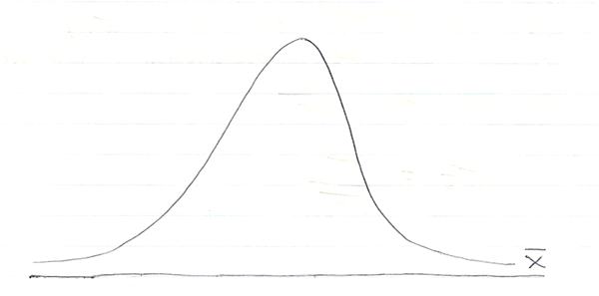
The Sampling Distribution of X̅
By the Central Limit Theorem, X̅ follows a normal distribution (for large n):

Slide 10

The Sampling Distribution of X̅
Since this is a normal distribution, we can standardize it (transform to Z) just like any other normal distribution.
If n is large, say 30 or more, use s as an unbiased estimate of σ.

Slide 11
Example- Steel Chains
Suppose you have steel chains with an average breaking strength of μ=200 lbs. with a σ=10 lbs., and you take a sample of n=100 chains.
What is the probability that the sample mean breaking strength will be 195 lbs. or less? This is the same as asking: What proportion of the sample means will be X̅ =195 lbs. or less?

Slide 12
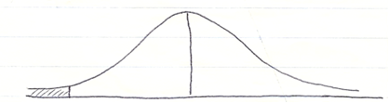

Example- Steel Chains
Solution (Draw a picture!)
Z = = -5
Ans: The probability is close to zero.

Slide 13
Other Sampling Distributions
We have been looking at the relationship between X̅ and µ.
Of course, statisticians will often be interested in estimating other parameters such as the population proportion (P), the population standard deviation (σ), the population median, etc.
In each case we use a statistic from a sample to estimate the parameter. Each of these statistics has its own sampling distribution.

Slide 14
Implications
The relationship between X̅ and µ is the foundation of statistical inference
Statistical inference includes estimation (of µ) and testing hypotheses (about µ)
Since there are so many X̅’s – as many as there are possible samples - we use the X̅ value we happened to get as a tool to make inferences about the only true mean, µ.
Without actually conducting a census we can never know µ with 100% certainty

